Slide 1

LOVELY PROFESSIONAL UNIVERSITY
Programme and Section: CSE(Hons) KM074
Course Code INT217
Under the Guidance of
Komal Arora: 17783
Discipline of CSE/IT
Lovely School of Computer Science and Engineering
Lovely Professional University, Phagwara
Submitted by
Pochana Anand Kumar Reddy
Registration No:11807873

Slide 2
CONTENTS
Introduction
Source of dataset
ETL process
Analysis on dataset (for each analysis)
Analysis Result
List of Analysis with results
References

Slide 3
INTRODUCTION
India is the world's third-largest producer and third-largest consumer of electricity.
The national electric grid in India has an installed capacity of 370.106 GW as of 31 March 2020. Renewable power plants, which also include large hydroelectric plants, constitute 35.86% of India's total installed capacity.
I made a structured dataset by collecting and adjusting various information from the datasets
This Data Provides Electricity Consumption from 2019-2020
Data were measured from 2019 to 2020 in India

Slide 4
Source of Dataset
Kaggle: https://www.kaggle.com/twinkle0705/state-wise-power-consumption-in-india
Author of the Dataset: Twinkle Khanna
Data Last Updated: June 2020

Slide 5
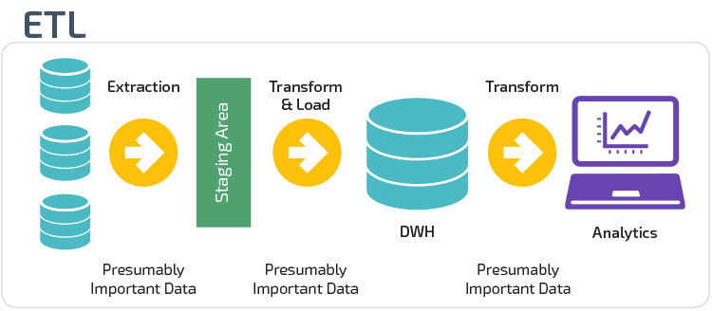
ETL Process
ETL stands for “extract, transform, and load.”
The process of ETL plays a key role in data integration strategies. ETL allows businesses to gather data from multiple sources and consolidate it into a single, centralized location. ETL also makes it possible for different types of data to work together.
A typical ETL process collects and refines different types of data, then delivers the data to a data warehouse such as Redshift, Azure, or Big Query.
ETL also makes it possible to migrate data between a variety of sources, destinations, and analysis tools. As a result, the ETL process plays a critical role in producing business intelligence and executing broader data management strategies.
Three steps make up the ETL process and enable data to be integrated from source to destination. These are data extraction, data transformation, and data loading.

Slide 6
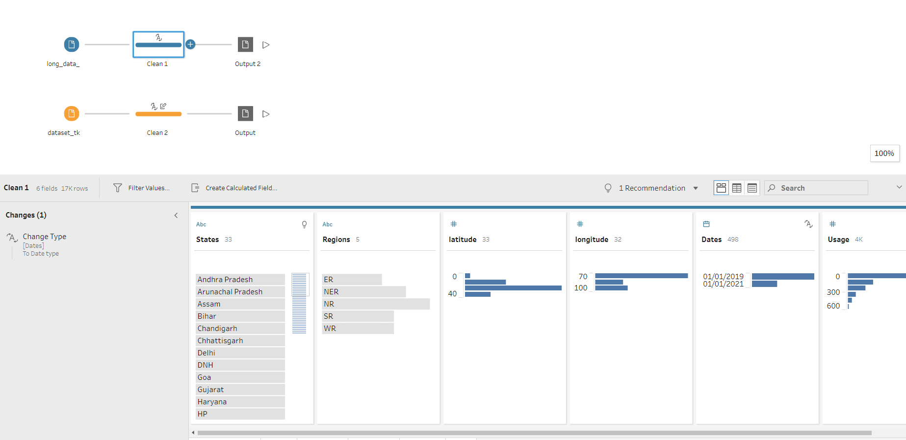
ETL Processes of data

Slide 7
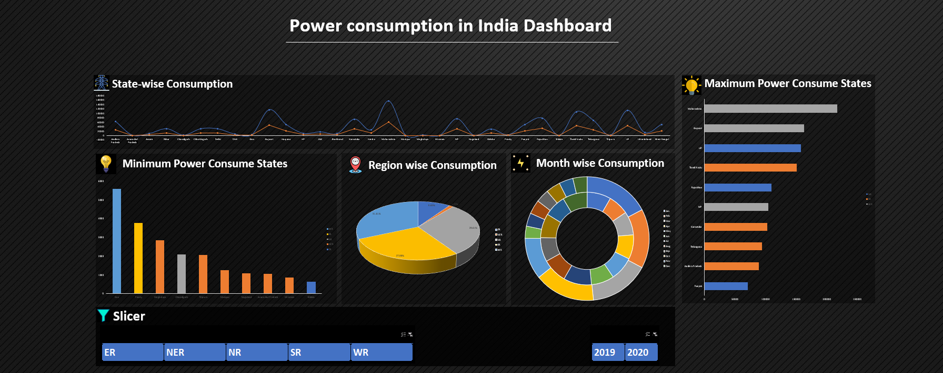
Dashboard

Slide 8
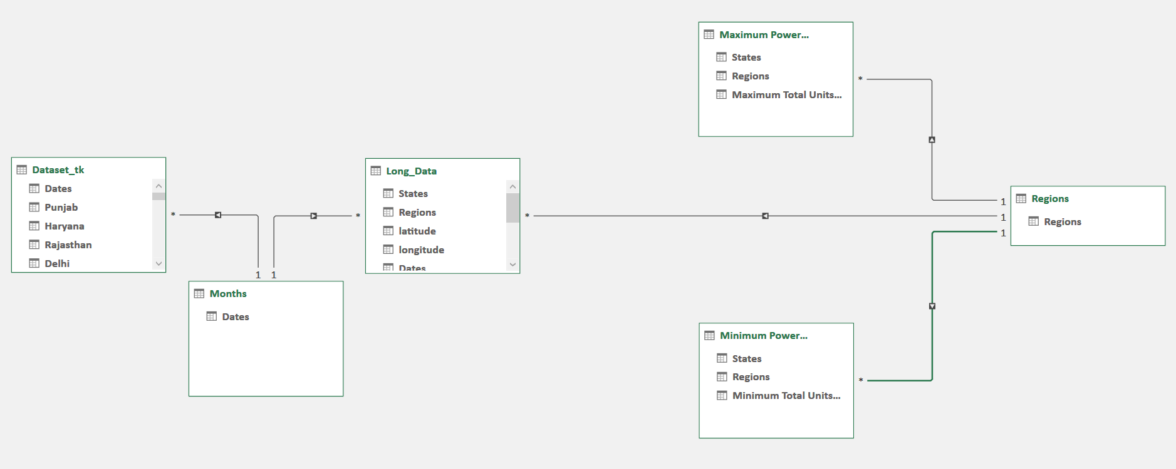
Diagram View

Slide 9
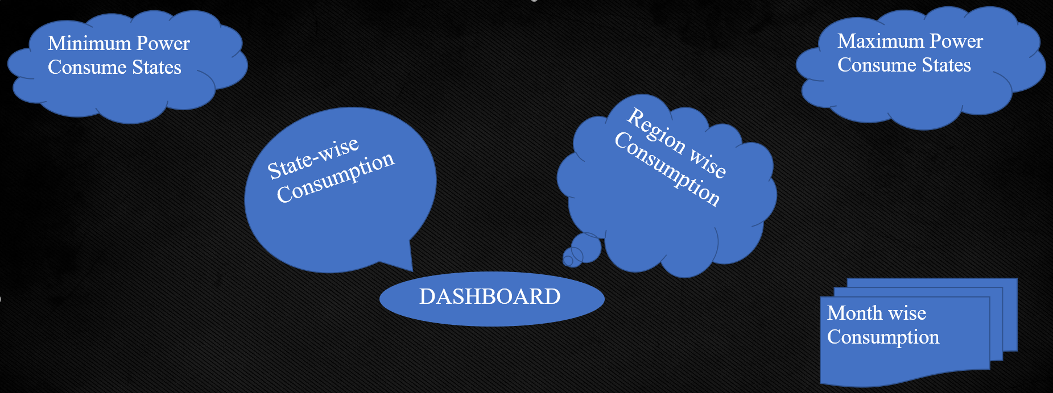
Hyperlink
These types of links are called hyperlinks.
These are used to redirect between pages.
Hyperlinks are created for every page.
Here we can see there are 5 objectives and 5 hyperlinks are created for this.

Slide 10
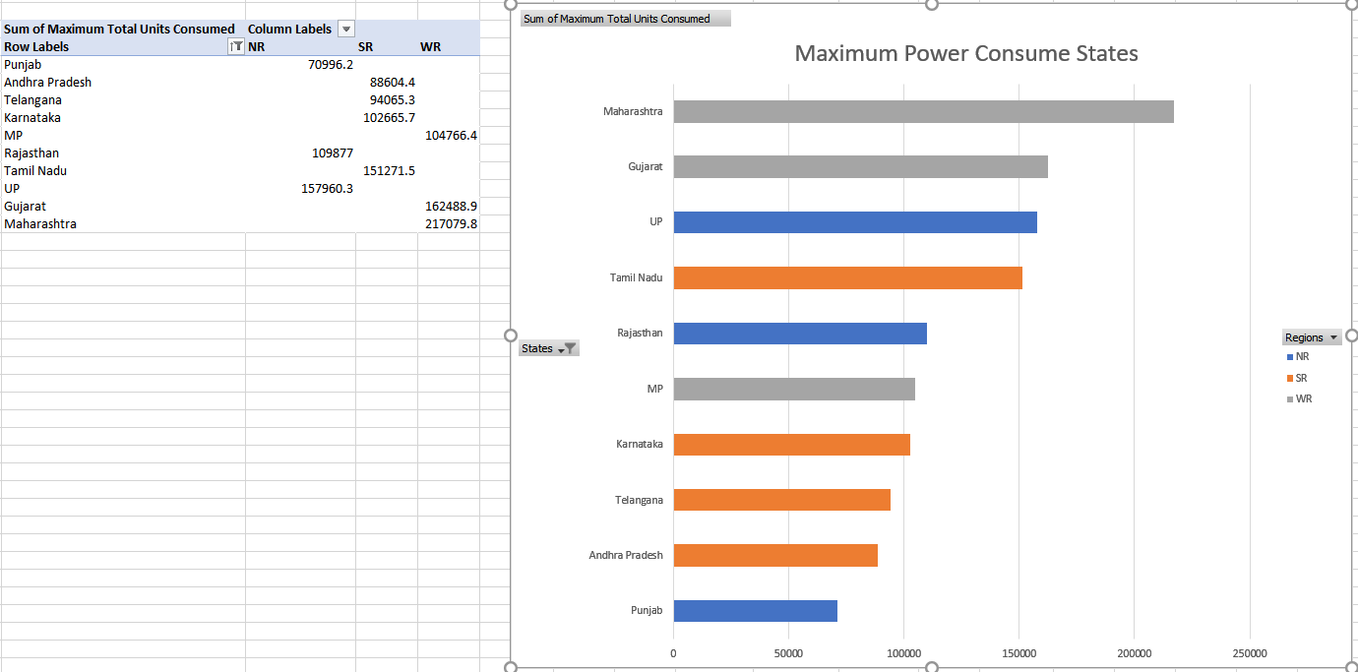
Analysis Results

Slide 11
Visualization

Slide 12
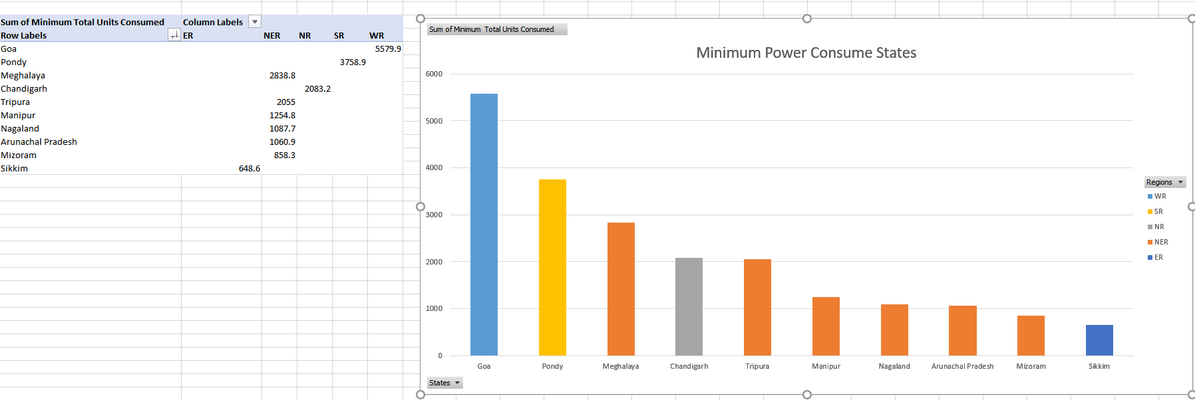
Analysis Results

Slide 13
Visualization

Slide 14
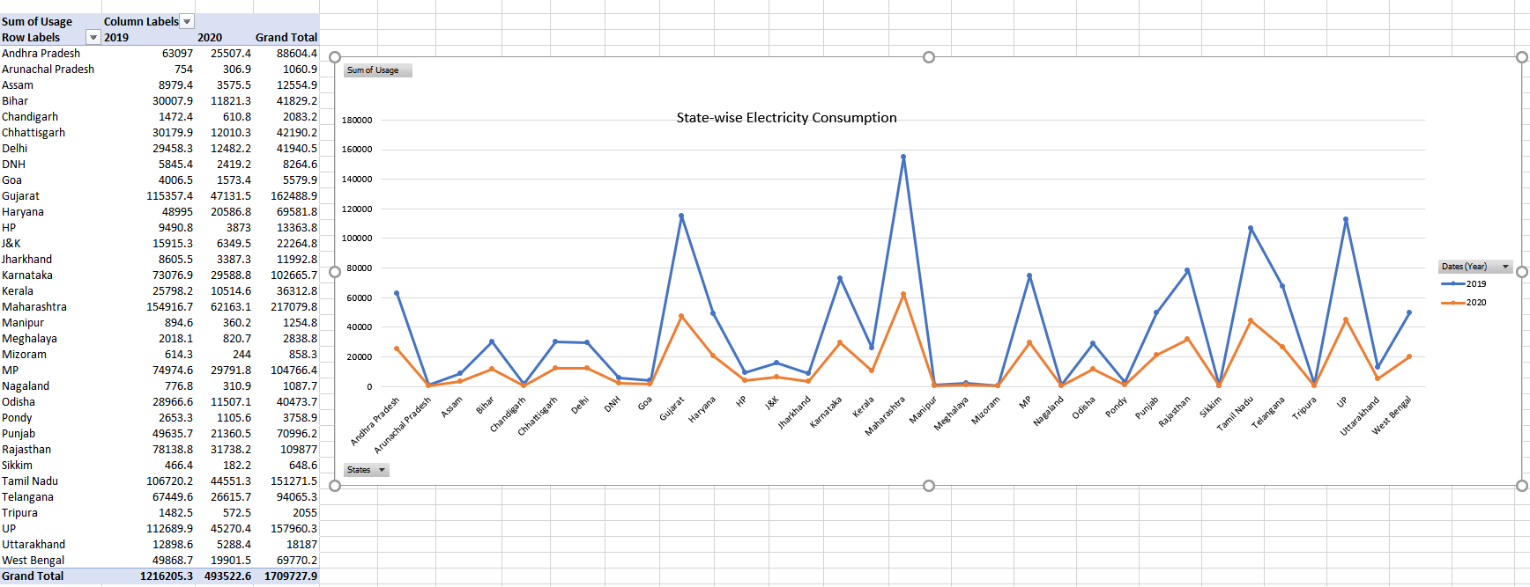
Analysis Results

Slide 15
Visualization

Slide 16
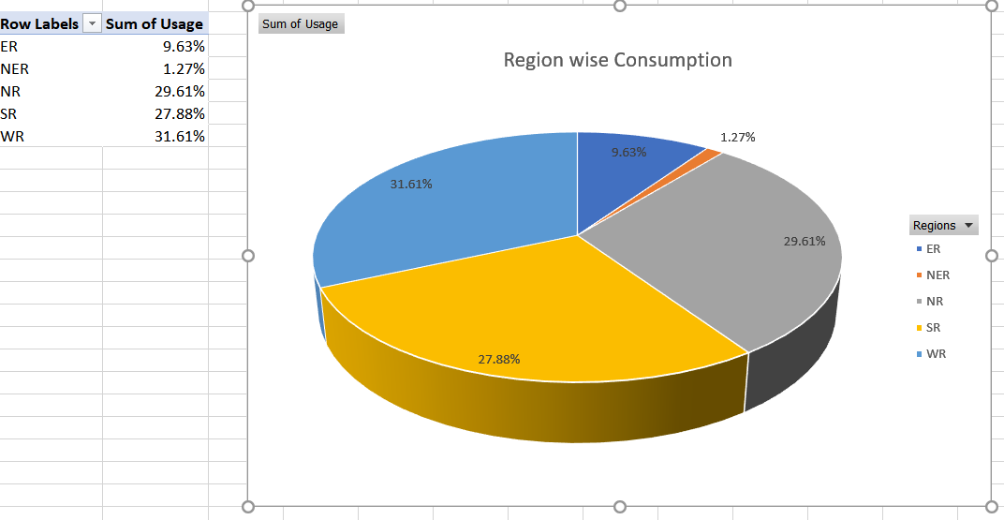
Analysis Results

Slide 17
Visualization

Slide 18
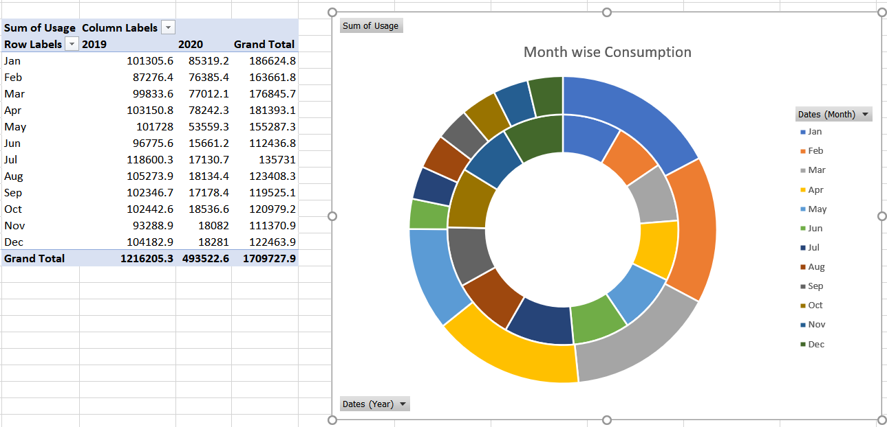
Analysis Results

Slide 19
Visualization

Slide 20
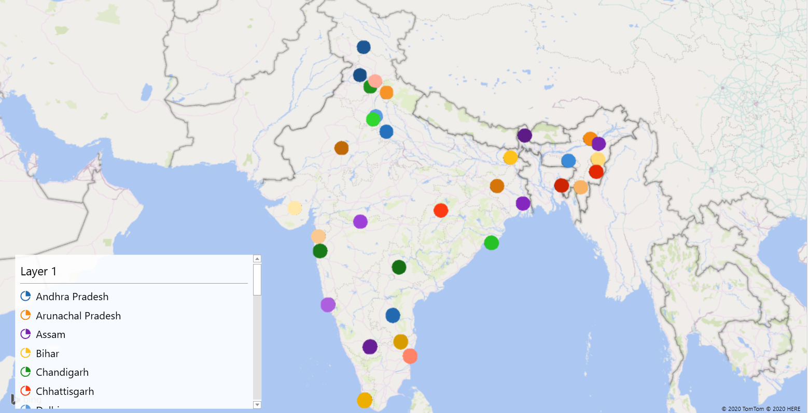
3D MAP

Slide 21
List of Analysis with results
Maharashtra state consume 12.7% power. It is the highest Electricity Consumption State.
Sikkim state consume 0.0379% power. It is lowest Electricity Consumption State.
In this pandemic time over all Regions Electricity Consumption is decreasing comparatively last year.
In all Regions, when the summer is starting that time the usage of Electricity is started increasing middle of February the power usage started increasing.
October and November are usually cloudless so that time the usage of Electricity is low.

Slide 22
References
www.kaggle.com
www.stackoverflow.com
www.google.com
www.youtube.com
www.github.com

